Slide 1
SPARSE MATRIX-VECTOR MULTIPLICATION
CUDA Implementation
SUKJOON OH

Slide 2
Contents
Sparse Matrix-Vector Multiplication
Sparse Matrix Representations (Format)
Library : CUSP and cuSPARSE
CUDA Implementation

Slide 3

1
Sparse Matrix-Vector Multiplication (SpMV)
Sparse Matrix : Matrix in which most of the elements are zero.
SpMV : Sparse Matrix-Vector (Multiplication)
$$y=Ax$$
Sparse Matrix
Usual matrix formats (dense formats) are not efficient for implementing kernel
Memory is wasted for storing zero values and the computing power lost in many multiplications by zero.

Slide 4
2
Sparse Matrix Representation
References
Bell, N., & Garland, M. (2008). Efficient sparse matrix-vector multiplication on CUDA (Vol. 2, No. 5). Nvidia Technical Report NVR-2008-004, Nvidia Corporation.
Bell, N., & Garland, M. (2009, November). Implementing sparse matrix-vector multiplication on throughput-oriented processors. In Proceedings of the conference on high performance computing networking, storage and analysis (pp. 1-11).
Benatia, A., Ji, W., Wang, Y., & Shi, F. (2018). BestSF: a sparse meta-format for optimizing SpMV on GPU. ACM Transactions on Architecture and Code Optimization (TACO), 15(3), 1-27.
Saad, Y. (2003). Iterative methods for sparse linear systems. Society for Industrial and Applied Mathematics. P.92-

Slide 5
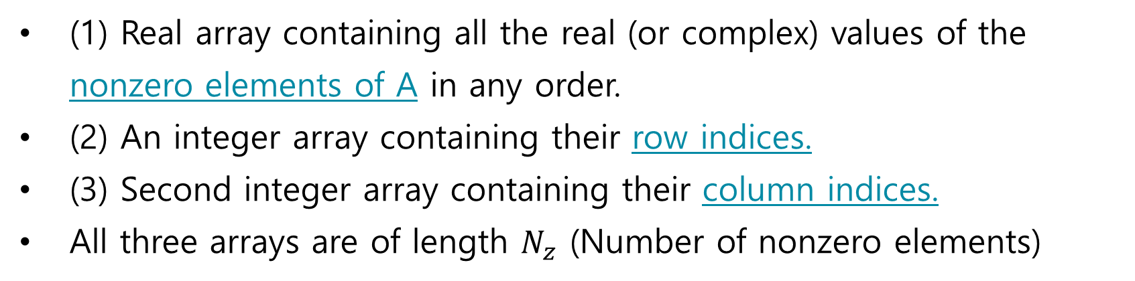
2
Sparse Matrix Representation
1. Coordinate Format (COO)
(1) Real array containing all the real (or complex) values of the nonzero elements of A in any order.
(2) An integer array containing their row indices.
(3) Second integer array containing their column indices.
All three arrays are of length $N_{z}$ (Number of nonzero elements)

Slide 6
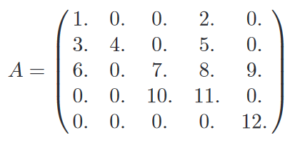
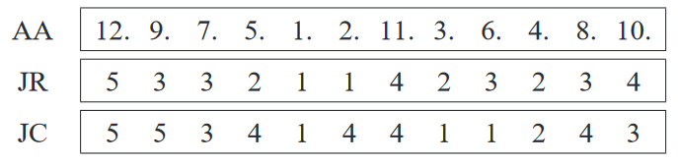
2
Sparse Matrix Representation
1. Coordinate Format (COO)
Coord (x, y)
Coord (x, y)
Elements are usually listed by row or columns.

Slide 7
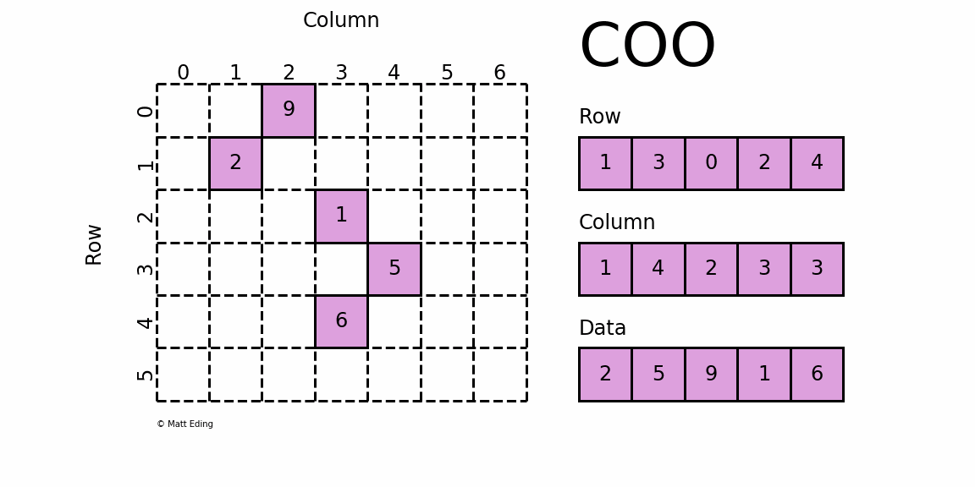
2
Sparse Matrix Representation
1. Coordinate Format (COO)
If the elements were listed by row, the array JC might be replaced by an array which points to the beginning of each row instead.

Slide 8
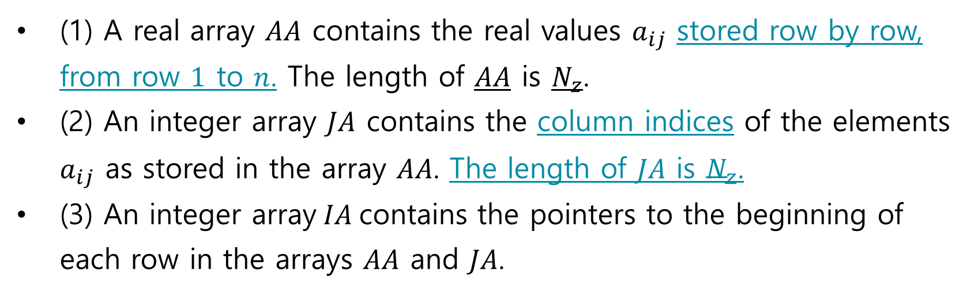
2
Sparse Matrix Representation
2. Compressed Sparse Row (CSR)
(1) A real array $AA$ contains the real values $a_{ij}$ stored row by row, from row $1$ to $n$. The length of $AA$ is $N_{z}$.
(2) An integer array $JA$ contains the column indices of the elements $a_{ij}$ as stored in the array $AA$. The length of $JA$ is $N_{z}$.
(3) An integer array$IA$contains the pointers to the beginning of each row in the arrays $AA$ and $JA$.

Slide 9
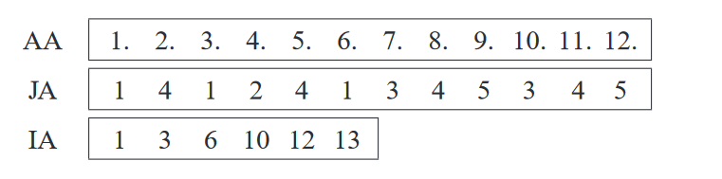
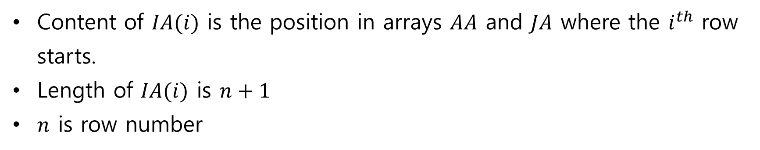
2
Sparse Matrix Representation
2. Compressed Sparse Row (CSR)
Content
Column Idx
Length
Content of $IA(i)$ is the position in arrays $AA$ and $JA$ where the $i^{th}$ row starts.
Length of $IA(i)$ is $n+1$
$n$ is row number

Slide 10
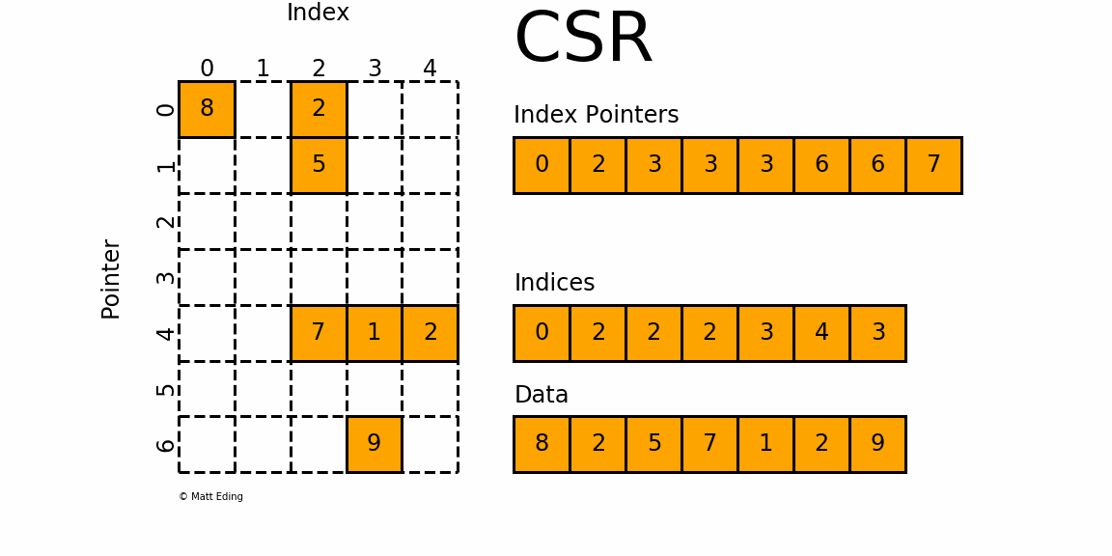
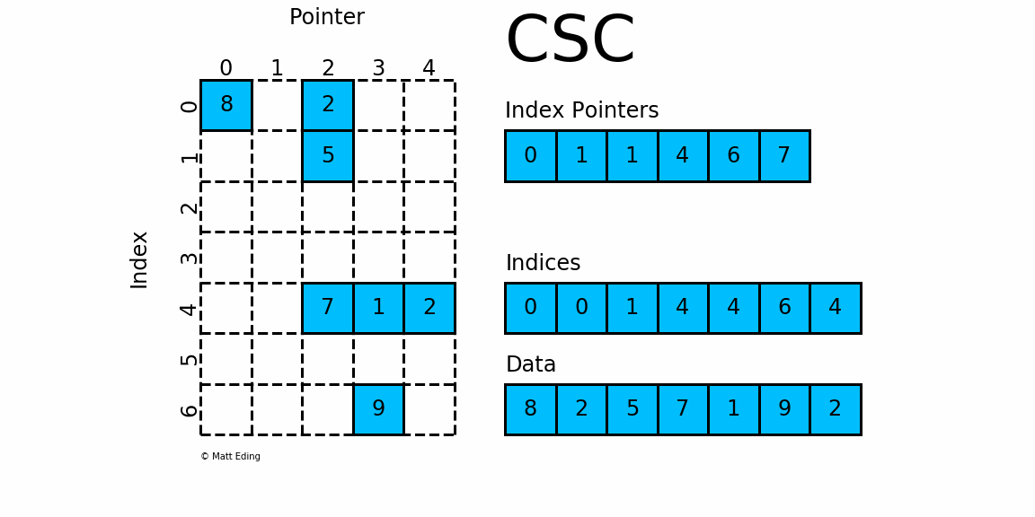
2
Sparse Matrix Representation
2. CSR Variations
Compressed Sparse Column (CSC)
Block Compressed Sparse Row (BCSR)

Slide 11
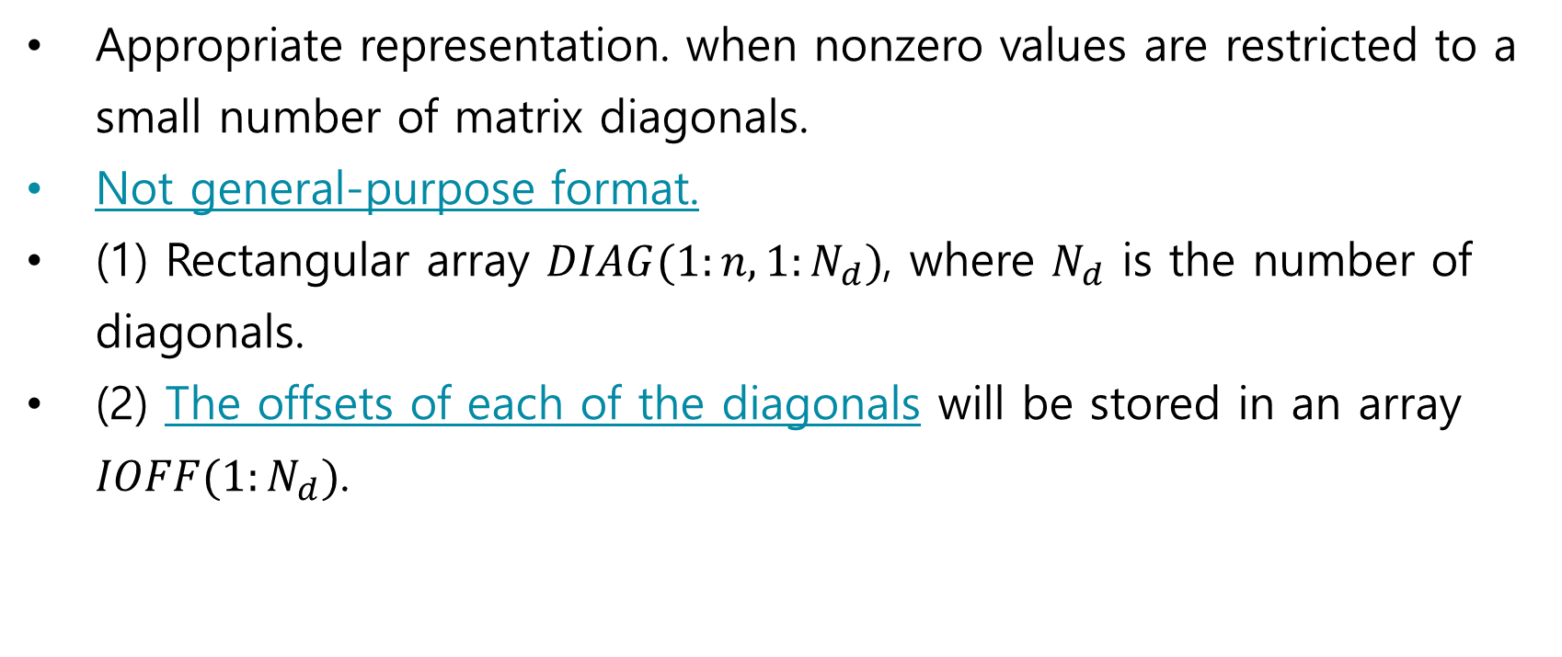
2
Sparse Matrix Representation
3. Diagonal Format (DIA)
Appropriate representation. when nonzero values are restricted to a small number of matrix diagonals.
Not general-purpose format.
(1) Rectangular array $DIAG(1:n,1:N_{d})$, where $N_{d}$ is the number of diagonals.
(2) The offsets of each of the diagonals will be stored in an array $IOFF(1:N_{d})$.

Slide 12
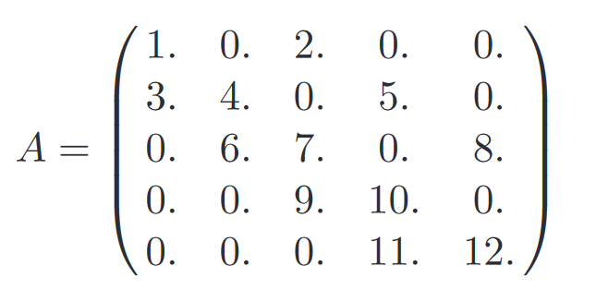
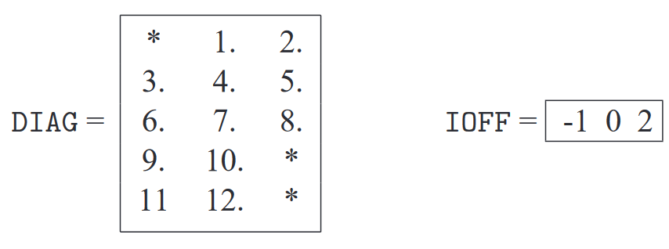

2
Sparse Matrix Representation
3. Diagonal Format (DIA)
$$DIAG\left(i, j\right) ←a_{i, i+ioff(j)}$$

Slide 13
2
Sparse Matrix Representation
3. Diagonal Format (DIA)
Main Diagonal (Offset 2)
Main Diagonal
Zero implies the main diagonal element
Offset 1
Offset 3

Slide 14
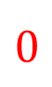
2
Sparse Matrix Representation
3. Diagonal Format (DIA)
*
*
$$0$$
*
Zero implies the main diagonal element

Slide 15
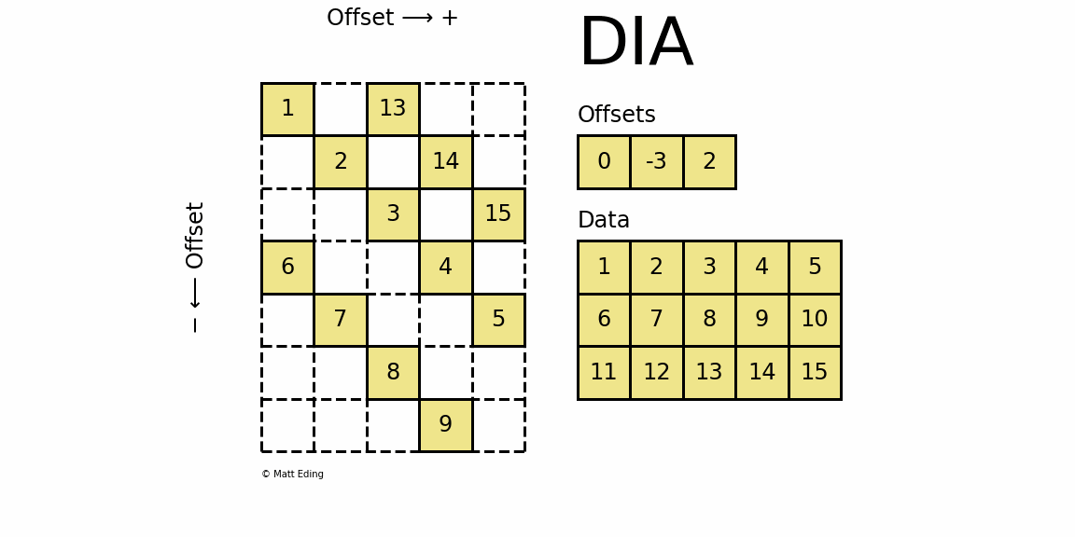
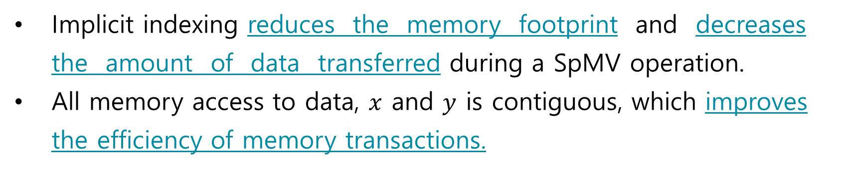
2
Sparse Matrix Representation
3. Diagonal Format (DIA)
Implicit indexing reduces the memory footprint and decreases the amount of data transferred during a SpMV operation.
All memory access to data, $x$ and $y$ is contiguous, which improves the efficiency of memory transactions.

Slide 16
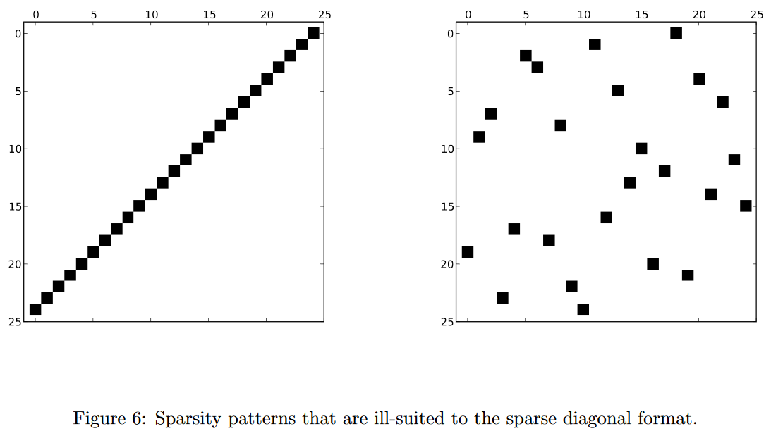
2
Sparse Matrix Representation
3. Diagonal Format (DIA)

Slide 17
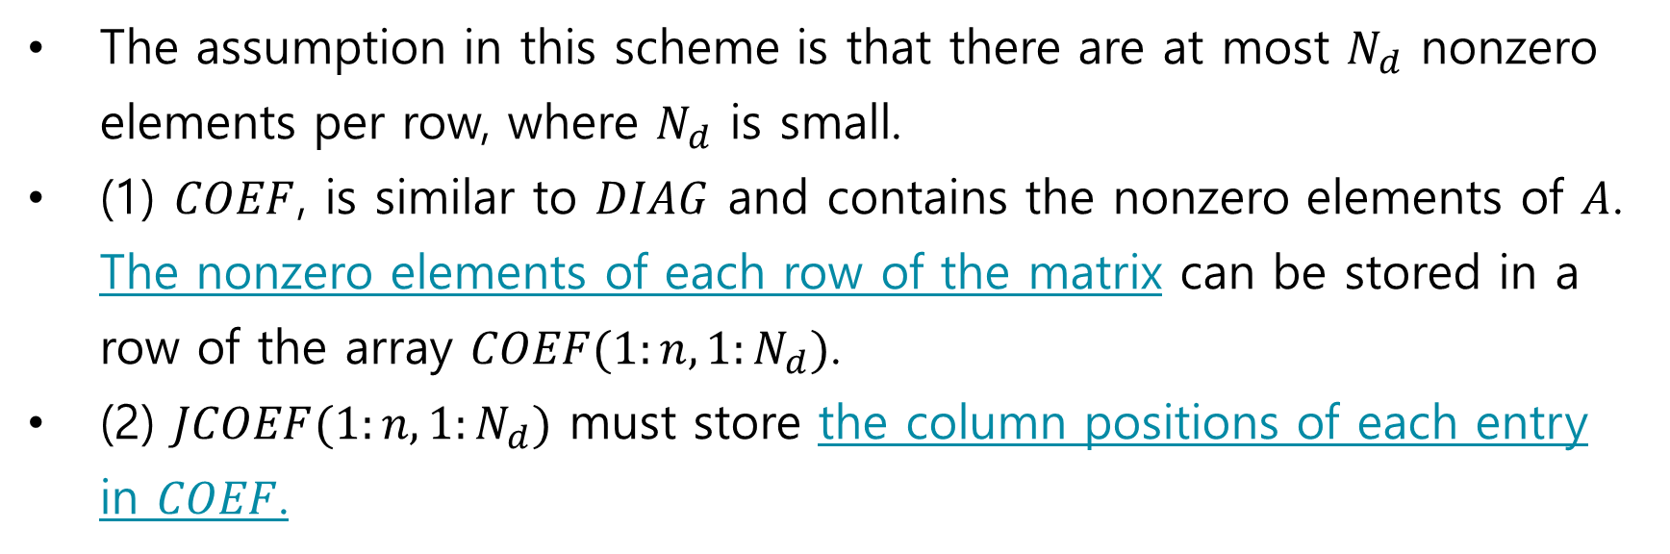
2
Sparse Matrix Representation
4. Ellpack-Itpack Format (ELL)
The assumption in this scheme is that there are at most $N_{d}$ nonzero elements per row, where $N_{d}$ is small.
(1) $COEF$, is similar to $DIAG$ and contains the nonzero elements of $A$. The nonzero elements of each row of the matrix can be stored in a row of the array $COEF(1:n,1:N_{d})$.
(2) $JCOEF(1:n,1:N_{d})$ must store the column positions of each entry in $COEF$.

Slide 18
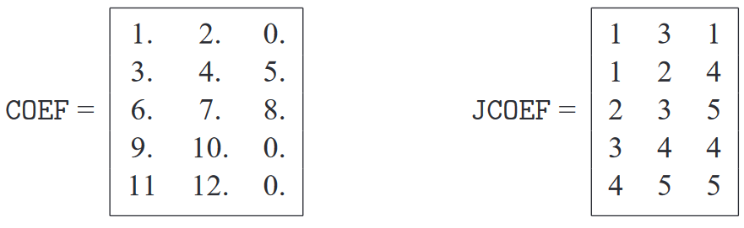

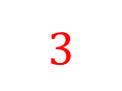
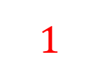
2
Sparse Matrix Representation
4. Ellpack-Itpack Format (ELL)
$$1$$
$$3$$
$$DIAG$$
In this example, those integers are selected to be equal to the row numbers

Slide 19
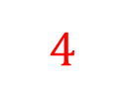
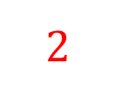
2
Sparse Matrix Representation
4. Ellpack-Itpack Format (ELL)
$$1$$
$$2$$
$$4$$
$$DIAG$$
In this example, those integers are selected to be equal to the row numbers

Slide 20
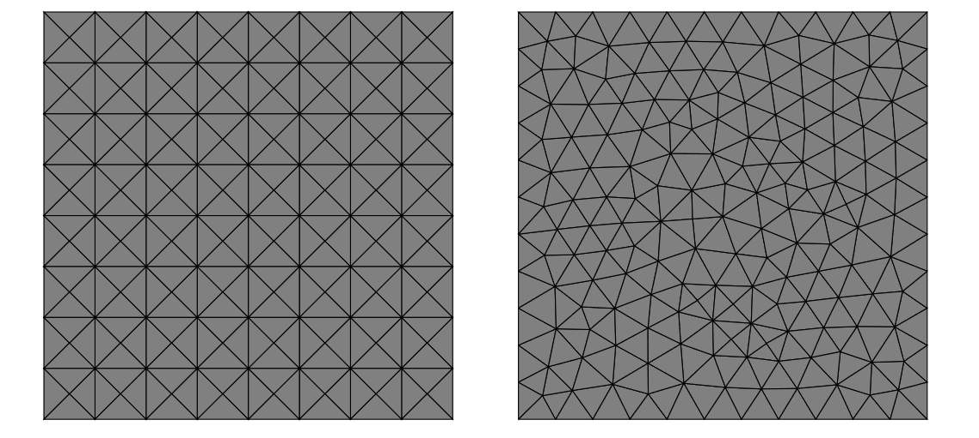
2
Sparse Matrix Representation
4. Ellpack-Itpack Format (ELL)
ELL is more general than DIA since the nonzero columns need not follow any particular pattern.
The maximum vertex degree is not significantly greater than the average degree.
In practice, unstructured meshes do not always meet this requirement.

Slide 21
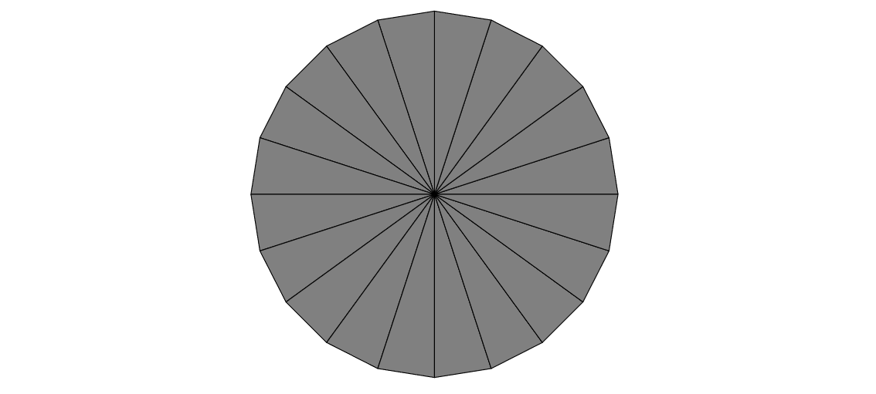
2
Sparse Matrix Representation
4. Ellpack-Itpack Format (ELL)
The vertex-edge connectivity of the wheel is not efficiently encoded in ELL format.
The vast majority of the entries in the data and indices arrays of the ELL representation will be wasted.

Slide 22
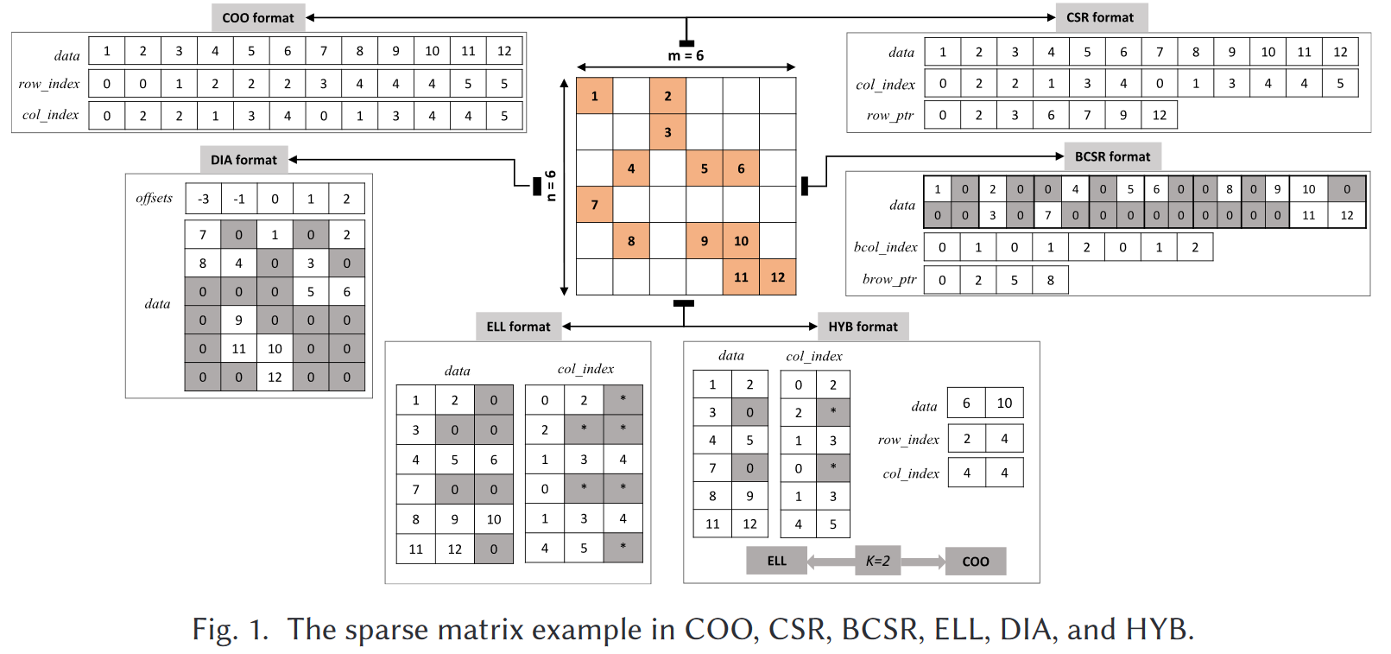
2
Sparse Matrix Representation

Slide 23
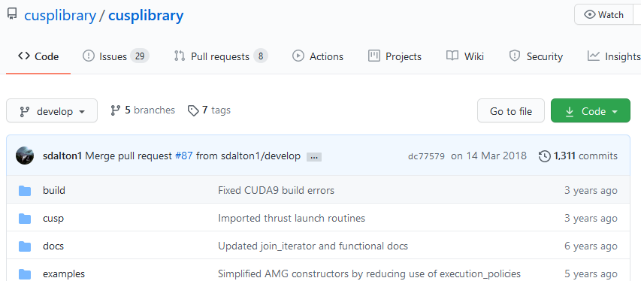
3
Library : CUSP (open source)
http://cusplibrary.github.io/
Cusp is a library for sparse linear algebra and graph computations based on Thrust.
Current release : v0.5.1 (April 28, 2015)

Slide 24
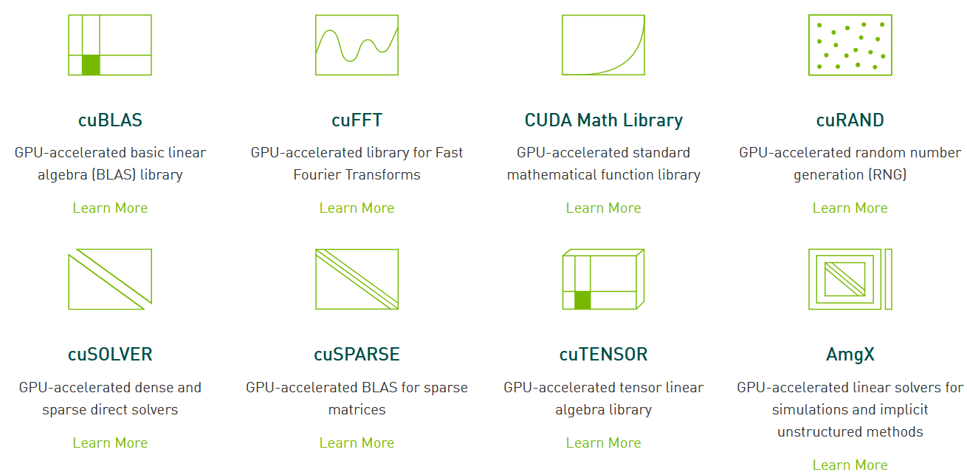
3
Library : CUDA Toolkit
https://docs.nvidia.com/cuda/pdf/CUSPARSE_Library.pdf

Slide 25
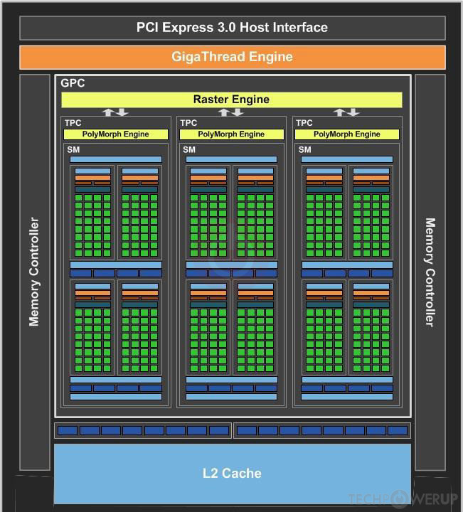
4
CUDA Implementation
1. Environment
GeForce 940M
Maxwell Architecture (1st gen) : GM108
CUDA Compute Compatibility : CUDA 5.0
1 GPC
3 Maxwell Streaming Multiprocessors
128 CUDA core in a single SMM
384 CUDA Cores

Slide 26
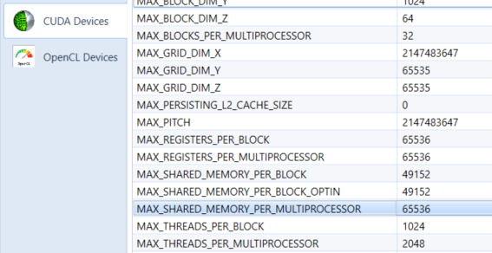
4
CUDA Implementation
1. Environment
Max number of concurrent warps/SMM : 64
Max number of thread blocks/SM : 32
Register File Size : 64KB
Shared memory: 64KB

Slide 27
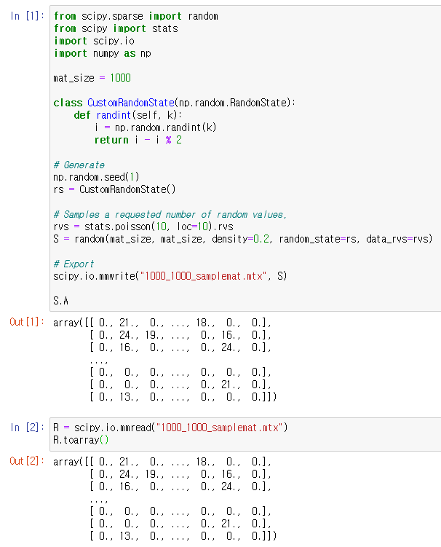
4
CUDA Implementation
2. Matrix Random Generation
https://docs.scipy.org/doc/scipy/reference/sparse.html

Slide 28
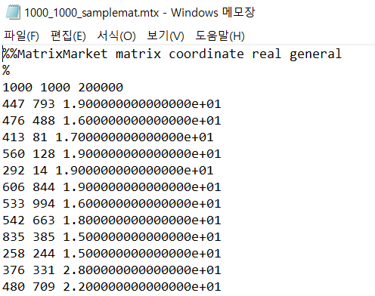
4
CUDA Implementation
3. Matrix Market (MM) Exchange Format
Coordinate Format : suitable for representing general sparse matrices.
Only nonzero entries are provided, and the coordinates of each nonzero entry is given explicitly.
Rows, Columns, entries(L)
L lines
https://math.nist.gov/MatrixMarket/formats.html

Slide 29
4
CUDA Implementation
http://math.nist.gov/MatrixMarket/mmio/c/mmio.h
http://math.nist.gov/MatrixMarket/mmio/c/mmio.c
4. Reading Matrix
void read_matrix(int* argJR, int* argJC, double* argAA) {
int m = M;
int n = N;
int nz = NZ;
FILE* MTX;
MM_typecode matrix_code;
MTX = fopen("10_10_sample_mat.mtx", "r");

Slide 30
4
CUDA Implementation
http://math.nist.gov/MatrixMarket/mmio/c/mmio.h
http://math.nist.gov/MatrixMarket/mmio/c/mmio.c
4. Reading Matrix
// Read banner, type, etc essential infos
// Verification steps are ignored.
if (mm_read_banner(MTX, &matrix_code) != 0) exit(1);
mm_read_mtx_crd_size(MTX, &m, &n, &nz); // Over max 1025
printf("Market Market type: [%s]\n", mm_typecode_to_str(matrix_code));
// COO format
for (register int i = 0; i < NZ; i++)
fscanf_s(MTX, "%d %d %lf\n", &argJR[i], &argJC[i], &argAA[i]);
fclose(MTX);
}
Read banner and size info

Slide 31
4
CUDA Implementation
4. Reading Matrix
// ---- main() ----
int main() {
int* JR = (int*)malloc(NZ * sizeof(int));
int* JC = (int*)malloc(NZ * sizeof(int));
double* AA = (double*)malloc(NZ * sizeof(double));
// prepare elements
read_matrix(JR, JC, AA);
COO Example (Slide 8)

Slide 32
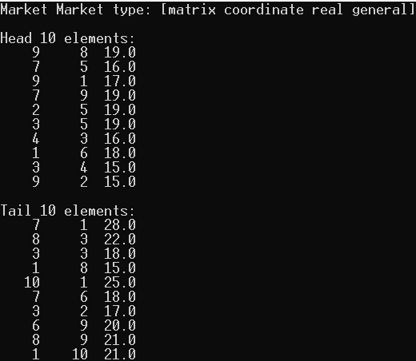
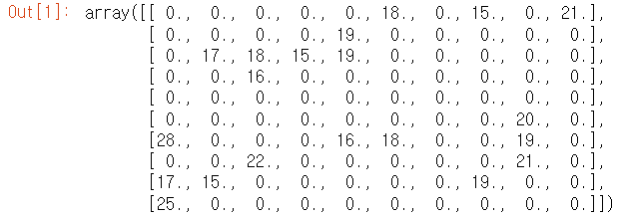
4
CUDA Implementation
4. Reading Matrix
COO Format is not sorted by rows.
cuSPARSE’s data type assumes all elements are row-sorted.
Order is important for transformation.

Slide 33
4
CUDA Implementation
5. Implementation
Sorting COO format using cuSPARSE
COO SpMV using cuSPARSE
CSR SpMV using cuSPARSE
CSR SpMV using scalar kernel
CSR SpMV using grid-stride kernel

Slide 34
4
CUDA Implementation
5.1 Sorting COO format using cuSPARSE
//
// ---- Step 2. Handle create, bind a stream ----
int* device_JR = NULL;
int* device_JC = NULL;
double* device_AA = NULL;
double* device_AA_sorted = NULL;
int* device_P = NULL;
void* buffer = NULL;
size_t buffer_size = 0;
On device

Slide 35
4
CUDA Implementation
5.1 Sorting COO format using cuSPARSE
Pointer of cuSPARSE context
cusparseHandle_t handle = NULL;
cudaStream_t stream = NULL;
CUDA_ERR(cudaStreamCreateWithFlags(&stream, cudaStreamNonBlocking));
CUSPARSE_ERR(cusparseCreate(&handle));
CUSPARSE_ERR(cusparseSetStream(handle, stream));
CUSPARSE_ERR( // ---- Step 3. Allocate Buffer ----
cusparseXcoosort_bufferSizeExt(
handle,
M, N, NZ,
device_JR, device_JC, &buffer_size
)
);
Creates a new asynchronous stream.
The flags determine the behaviors of the stream.
Output

Slide 36
4
CUDA Implementation
5.1 Sorting COO format using cuSPARSE
CUDA_ERR(cudaMalloc((void **)&device_JR, sizeof(int) * NZ));
CUDA_ERR(cudaMalloc((void **)&device_JC, sizeof(int) * NZ));
CUDA_ERR(cudaMalloc((void **)&device_P, sizeof(int) * NZ));
CUDA_ERR(cudaMalloc((void **)&device_AA, sizeof(double) * NZ));
CUDA_ERR(cudaMalloc((void **)&device_AA_sorted, sizeof(double) * NZ));
CUDA_ERR(cudaMalloc((void **)&buffer, sizeof(char) * buffer_size));
CUDA_ERR(cudaMemcpy(device_JR, host_JR, sizeof(int) * NZ, cudaMemcpyHostToDevice));
CUDA_ERR(cudaMemcpy(device_JC, host_JC, sizeof(int) * NZ, cudaMemcpyHostToDevice));
CUDA_ERR(cudaMemcpy(device_AA, host_AA, sizeof(double) * NZ, cudaMemcpyHostToDevice));
CUDA_ERR(cudaDeviceSynchronize());

Slide 37
4
CUDA Implementation
5.1 Sorting COO format using cuSPARSE
//
// ---- Step 4. Setup permutation vector P to Identity ----
CUSPARSE_ERR(cusparseCreateIdentityPermutation(handle, NZ, device_P));
// ---- Step 5. Sort ----
CUSPARSE_ERR(
cusparseXcoosortByRow(handle, M, N, NZ, device_JR, device_JC, device_P, buffer)
);
// Gather
CUSPARSE_ERR(cusparseDgthr(
handle, NZ, device_AA, device_AA_sorted, device_P, CUSPARSE_INDEX_BASE_ZERO));
CUDA_ERR(cudaDeviceSynchronize());
Gathers the elements of the vector listed in the index array into the second vector.

Slide 38
4
CUDA Implementation
5.1 Sorting COO format using cuSPARSE
// Fetch back
CUDA_ERR(cudaMemcpy(host_JR, device_JR, sizeof(int) * NZ, cudaMemcpyDeviceToHost));
CUDA_ERR(cudaMemcpy(host_JC, device_JC, sizeof(int) * NZ, cudaMemcpyDeviceToHost));
CUDA_ERR(cudaMemcpy(host_P, device_P, sizeof(int) * NZ, cudaMemcpyDeviceToHost));
CUDA_ERR(cudaMemcpy(host_AA, device_AA_sorted, sizeof(double) * NZ, cudaMemcpyDeviceToHost));
CUDA_ERR(cudaDeviceSynchronize());
No __global__ syntax.
cuSPARSE API controls everything.

Slide 39
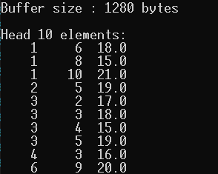
4
CUDA Implementation
5.1 Sorting COO format using cuSPARSE
Elements are sorted by row nicely!

Slide 40

4
CUDA Implementation
5.2 COO SpMV using cuSPARSE
// ---- Step 7. Define variables
const float alpha = 1;
const float beta = 0;
float host_y[N] = {0, };
float host_x[M];
float* device_x = NULL;
float* device_y = NULL;
for (auto& elem : host_x) elem = 1;
$$y=Ax$$

Slide 41
4
CUDA Implementation
5.2 COO SpMV using cuSPARSE
Sparse Matrix Descriptor Type
cusparseSpMatDescr_t sp_mtx; // device
cusparseDnVecDescr_t dn_x, dn_y; // device
// ---- Step 8. Get your GPU memory ready ----
CUDA_ERR(cudaMalloc((void**)&device_x, sizeof(float) * M));
CUDA_ERR(cudaMalloc((void**)&device_y, sizeof(float) * N));
CUDA_ERR(cudaMemcpy(device_x, host_x, sizeof(float) * M, cudaMemcpyHostToDevice));
CUDA_ERR(cudaMemcpy(device_y, host_y, sizeof(float) * N, cudaMemcpyHostToDevice));
CUSPARSE_ERR(cusparseCreate(&handle));
Dense Vector Descriptor Type

Slide 42
4
CUDA Implementation
5.2 COO SpMV using cuSPARSE
// Create sparse matrix in COO format
CUSPARSE_ERR(
cusparseCreateCoo(
&sp_mtx,
M, N, NZ, device_JR, device_JC, device_AA_sorted,
CUSPARSE_INDEX_32I, CUSPARSE_INDEX_BASE_ONE, CUDA_R_32F)
);
CUSPARSE_ERR(cusparseCreateDnVec(&dn_x, N, device_x, CUDA_R_32F));
CUSPARSE_ERR(cusparseCreateDnVec(&dn_y, M, device_y, CUDA_R_32F));
Real 32 Float : Precision
Index starting point

Slide 43
4
CUDA Implementation
5.2 COO SpMV using cuSPARSE
CUSPARSE_ERR(cusparseSpMV_bufferSize(
handle, CUSPARSE_OPERATION_NON_TRANSPOSE,
&alpha, sp_mtx, dn_x, &beta, dn_y, CUDA_R_32F,
CUSPARSE_COOMV_ALG, &buffer_size));
printf("Buffer size : %lld bytes \n", (long long)buffer_size);
CUDA_ERR(cudaMalloc(&buffer, buffer_size));

Slide 44
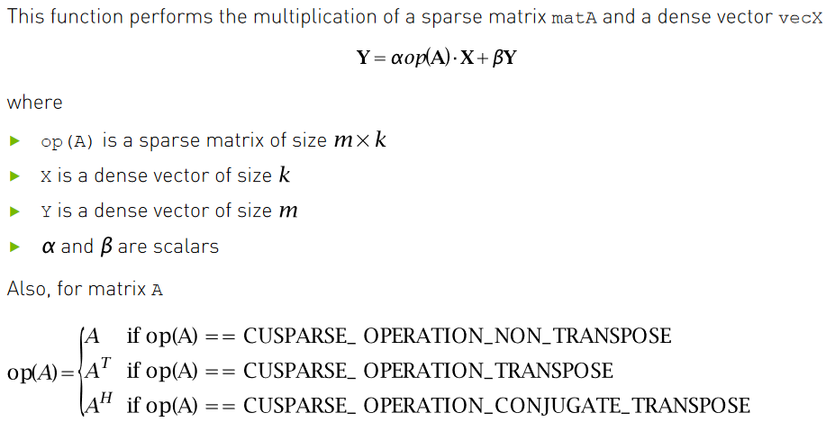
4
CUDA Implementation
5.2 COO SpMV using cuSPARSE

Slide 45
4
CUDA Implementation
5.2 COO SpMV using cuSPARSE
// ---- Step 9. Do SpMV ----
CUSPARSE_ERR(cusparseSpMV(handle, CUSPARSE_OPERATION_NON_TRANSPOSE,
&alpha, sp_mtx, dn_x, &beta, dn_y, CUDA_R_32F,
CUSPARSE_COOMV_ALG, buffer));
// ---- Step 10. Fetch the result ----
CUDA_ERR(cudaMemcpy(host_y, device_y, N * sizeof(float), cudaMemcpyDeviceToHost));
A/X, Y, ComputeType must be matched:
e.g. Uniform-precision: Set everything to CUDA_R_32F
Algorithm selection

Slide 46
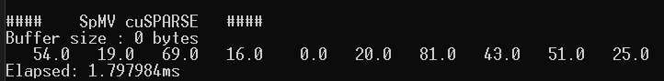
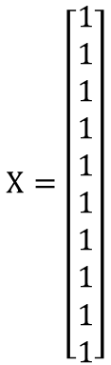
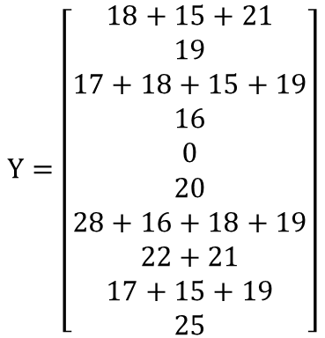
4
CUDA Implementation
5.2 COO SpMV using cuSPARSE
$$X=\left[\begin{aligned}1 \\ 1 \\ 1 \\ 1 \\ 1 \\ 1 \\ 1 \\ 1 \\ 1 \\ 1\end{aligned}\right]$$
$$Y=\left[\begin{aligned}18+15+21 \\ 19 \\ 17+18+15+19 \\ 16 \\ 0 \\ 20 \\ 28+16+18+19 \\ 22+21 \\ 17+15+19 \\ 25\end{aligned}\right]$$
Time recorded only at SpMV calculation step.

Slide 47
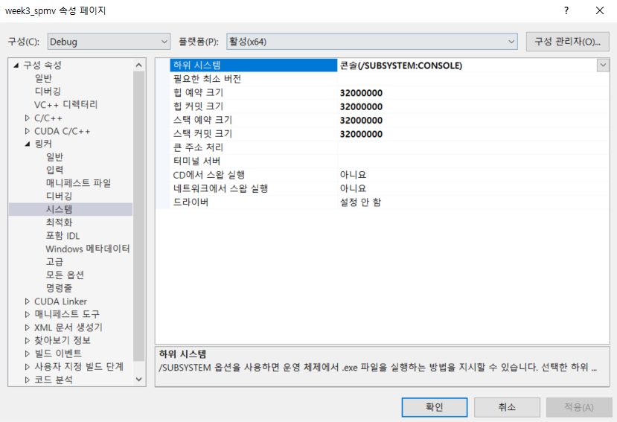
4
CUDA Implementation
5.2 COO SpMV using cuSPARSE
Matrix 1024 by 1024
Need to increase stack and heap size
Default stack : 1MB
Default heap : 1MB
Otherwise, stack overflow problem occurs.

Slide 48
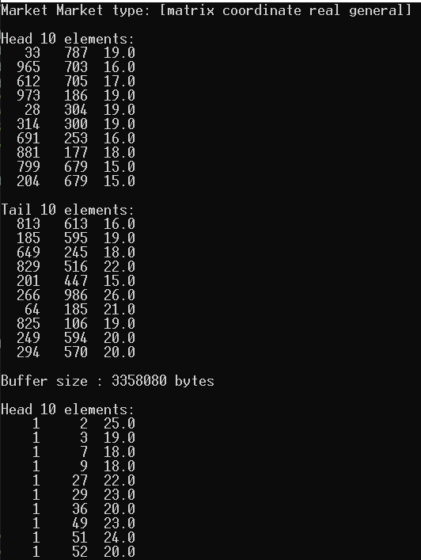
4
CUDA Implementation
5.2 COO SpMV using cuSPARSE
#define MTX_FILE "1024_1024_sample_mat.mtx“
#define M 1024
#define N 1024
#define NZ 209715

Slide 49
4
CUDA Implementation
5.3 CSR SpMV using cuSPARSE
Add below Step 6.
Transforms COO into CSR format.
#if defined( CUSPARSE_CSR )
int* t_JR = (int*)calloc((M + 1), sizeof(int));
int* t_JC = (int*)malloc(NZ * sizeof(int));
float* t_AA = (float*)malloc(NZ * sizeof(float));
for (int i = 0; i < M + 1; i++) t_JR[i]++;
for (int i = 0; i < NZ; i++) {
t_AA[i] = host_AA[i];
t_JC[i] = host_JC[i];
t_JR[host_JR[i]]++;
}
for (int i = 0; i < M; i++) t_JR[i + 1] += (t_JR[i] – 1);
Count
Accumulate

Slide 50
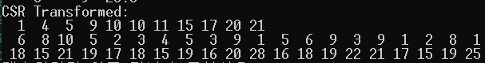
4
CUDA Implementation
5.3 CSR SpMV using cuSPARSE
free(host_JR);
free(host_JC);
free(host_AA);
host_JR = t_JR;
host_JC = t_JC;
host_AA = t_AA;
#endif

Slide 51
4
CUDA Implementation
5.3 CSR SpMV using cuSPARSE
Reduced memory space
#ifdef CUSPARSE_CSR
CUDA_ERR(cudaMalloc((void**)&device_JR, sizeof(int) * (M + 1)));
CUDA_ERR(cudaMalloc((void**)&device_JC, sizeof(int) * NZ));
CUDA_ERR(cudaMemcpy(device_JR, host_JR, sizeof(int) * (M + 1), cudaMemcpyHostToDevice));
CUDA_ERR(cudaMemcpy(device_JC, host_JC, sizeof(int) * NZ, cudaMemcpyHostToDevice));
#endif
Add below Step 8.
Additional communication between GPU and main memory.

Slide 52
4
CUDA Implementation
5.3 CSR SpMV using cuSPARSE
#ifndef CUSPARSE_CSR
CUSPARSE_ERR(
cusparseCreateCoo(
&sp_mtx,
M, N, NZ, device_JR, device_JC, device_AA_sorted,
CUSPARSE_INDEX_32I, CUSPARSE_INDEX_BASE_ONE, CUDA_R_32F)
);
#else
CUSPARSE_ERR(
cusparseCreateCsr(
&sp_mtx,
M, N, NZ, device_JR, device_JC, device_AA_sorted,
CUSPARSE_INDEX_32I, CUSPARSE_INDEX_32I, CUSPARSE_INDEX_BASE_ONE, CUDA_R_32F)
);
#endif

Slide 53
4
CUDA Implementation
5.3 CSR SpMV using cuSPARSE
#ifndef CUSPARSE_CSR
CUSPARSE_ERR(cusparseSpMV_bufferSize(
handle, CUSPARSE_OPERATION_NON_TRANSPOSE,
&alpha, sp_mtx, dn_x, &beta, dn_y, CUDA_R_32F,
CUSPARSE_COOMV_ALG, &buffer_size));
#else
CUSPARSE_ERR(cusparseSpMV_bufferSize(
handle, CUSPARSE_OPERATION_NON_TRANSPOSE,
&alpha, sp_mtx, dn_x, &beta, dn_y, CUDA_R_32F,
CUSPARSE_CSRMV_ALG1, &buffer_size));
#endif

Slide 54
4
CUDA Implementation
5.3 CSR SpMV using cuSPARSE
#ifndef CUSPARSE_CSR
CUSPARSE_ERR(cusparseSpMV(handle, CUSPARSE_OPERATION_NON_TRANSPOSE,
&alpha, sp_mtx, dn_x, &beta, dn_y, CUDA_R_32F,
CUSPARSE_COOMV_ALG, buffer));
#else
CUSPARSE_ERR(cusparseSpMV(handle, CUSPARSE_OPERATION_NON_TRANSPOSE,
&alpha, sp_mtx, dn_x, &beta, dn_y, CUDA_R_32F,
CUSPARSE_CSRMV_ALG1, buffer));
#endif

Slide 55
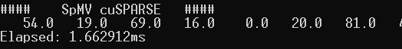
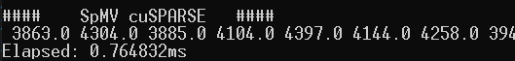
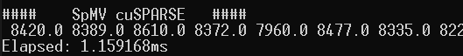
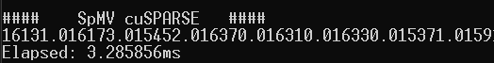
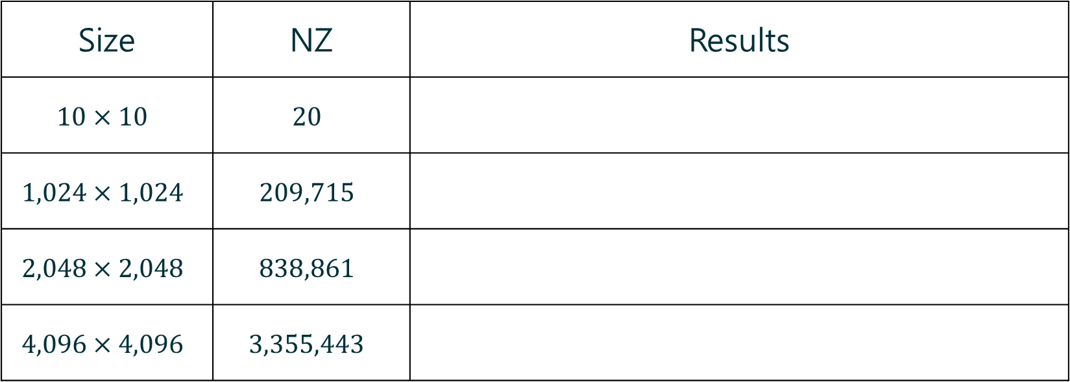
4
CUDA Implementation
5.3 CSR SpMV using cuSPARSE
COO Format
Size | NZ | Results
$$10×10$$ | $$20$$
$$1,024×1,024$$ | $$209,715$$
$$2,048×2,048$$ | $$838,861$$
$$4,096×4,096$$ | $$3,355,443$$

Slide 56
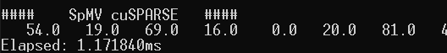
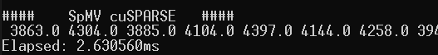
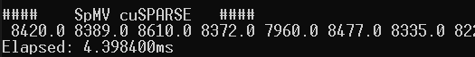
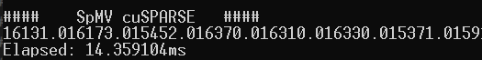
4
CUDA Implementation
5.3 CSR SpMV using cuSPARSE
CSR Format
Size | NZ | Results
$$10×10$$ | $$20$$
$$1,024×1,024$$ | $$209,715$$
$$2,048×2,048$$ | $$838,861$$
$$4,096×4,096$$ | $$3,355,443$$

Slide 57
4
CUDA Implementation
5.4 CSR SpMV using Kernel
Straightforward method: One thread per row.
Thread 0
Thread 9
Steinberger, M., Derlery, A., Zayer, R., & Seidel, H. P. (2016, September). How naive is naive SpMV on the GPU?. In 2016 IEEE High Performance Extreme Computing Conference (HPEC) (pp. 1-8). IEEE.

Slide 58
4
CUDA Implementation
5.4 CSR SpMV using Kernel
__global__ void ker_csr_spmv_scalar(
const int* argJR, const int* argJC, const float* argAA,
const float* arg_x, float* arg_y) {
int idx = blockDim.x * blockIdx.x + threadIdx.x;
float sum = 0;
for (int i = argJR[idx] - 1; i < argJR[idx + 1] - 1; i++)
sum += (argAA[i] * arg_x[argJC[i] - 1]);
arg_y[idx] += sum;
};

Slide 59
4
CUDA Implementation
5.4 CSR SpMV using Kernel
Straightforward method: Thread per row
Thread 0
Thread 1
Thread 2
Thread 3
…
Poor memory coalescing occurs.
Unaligned memory access.

Slide 60




4
CUDA Implementation
5.4 CSR SpMV using Kernel
ker_csr_spmv_scalar
Size | NZ | Results
$$10×10$$ | $$20$$
$$1,024×1,024$$ | $$209,715$$
$$2,048×2,048$$ | $$838,861$$
$$4,096×4,096$$ | $$3,355,443$$

Slide 61

4
CUDA Implementation
5.4 CSR SpMV using Kernel
Another method: One warp per row.
Warp 0
Warp 9
Total threads : $32×row$
Stride : $32$

Slide 62
4
CUDA Implementation
5.4 CSR SpMV using Kernel
__global__ void ker_csr_spmv_vector(
const int* argJR, const int* argJC, const float* argAA,
const float* arg_x, float* arg_y) {
int tid= blockDim.x * blockIdx.x + threadIdx.x;
int wid= tid / 32;
int lidx= tid & 31;
float sum= 0;
for (int i = argJR[wid] - 1 + lidx; i < argJR[wid + 1] - 1; i += 32)
sum += argAA[i] * arg_x[argJC[i] - 1];
for (int i = 16; i > 0; i /= 2)
sum += __shfl_down_sync(0xFFFFFFFF, sum, i);
if (lidx == 0) arg_y[wid] = sum;
};

Slide 63

4
CUDA Implementation
5.4 CSR SpMV using Kernel
The data exchange is performed between registers, and more efficient than going through shared memory.
For a thread at lane X in the warp, the function gets the value of the val variable from the thread at lane X+offset of the same warp.
Available over SM 3.0
__shfl_down_sync(FULL_MASK, val, offset)
https://developer.nvidia.com/blog/using-cuda-warp-level-primitives/

Slide 64
4
CUDA Implementation
5.4 CSR SpMV using Kernel
__device__ void segmented_reduction(
const int lane, const int * rows, float * vals) {
// segmented reduction in shared memory
if( lane >= 1 && rows[threadIdx.x] == rows[threadIdx.x - 1] )
vals[threadIdx.x] += vals[threadIdx.x - 1];
if( lane >= 2 && rows[threadIdx.x] == rows[threadIdx.x - 2] )
vals[threadIdx.x] += vals[threadIdx.x - 2];
if( lane >= 4 && rows[threadIdx.x] == rows[threadIdx.x - 4] )
vals[threadIdx.x] += vals[threadIdx.x - 4];
if( lane >= 8 && rows[threadIdx.x] == rows[threadIdx.x - 8] )
vals[threadIdx.x] += vals[threadIdx.x - 8];
if( lane >= 16 && rows[threadIdx.x] == rows[threadIdx.x - 16] )
vals[threadIdx.x] += vals[threadIdx.x - 16];
}

Slide 65
4
CUDA Implementation
5.4 CSR SpMV using Kernel
#ifdef KERNEL_CSR_VECTOR
#ifdef CASE1
ker_csr_spmv_vector <<<1, 32 * M>>>(
#endif
#ifdef CASE2
ker_csr_spmv_vector <<<32, 1024>>>(
#endif
#ifdef CASE3
ker_csr_spmv_vector <<<64, 1024>>>(
#endif
#ifdef CASE4
ker_csr_spmv_vector <<<128, 1024>>>(
#endif
device_JR, device_JC, device_AA_sorted, device_x, device_y
);
#endif

Slide 66




4
CUDA Implementation
5.4 CSR SpMV using Kernel
ker_csr_spmv_vector
Size | NZ | Results
$$10×10$$ | $$20$$
$$1,024×1,024$$ | $$209,715$$
$$2,048×2,048$$ | $$838,861$$
$$4,096×4,096$$ | $$3,355,443$$

